Slide 1
Chapter 6
Digital Search Structures

Slide 2
Binary Tries and Patricia
When the length of the key is very long, keys are of different length, digital search trees are inefficient.
To reduce the number of comparisons for searching, an efficient related structure called PATRICIA (Practical Algorithm to Retrieve Information Coded in Alphanumeric) is used.
By using Patricia, we can reduce the number of key comparisons done during a search to one.
The Patricia can be developed in three steps.
Step 1: Construct Binary Trie
Step 2: Transform Binary Trie into Compressed Binary Trie.
Step 3: Obtain Patricia from compressed Binary Trie.

Slide 3
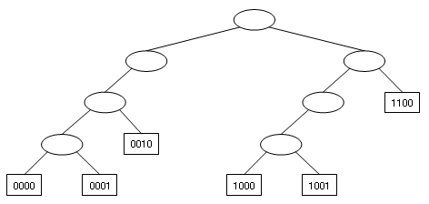
Binary Tries
A Binary Trie is a binary tree with two possible nodes namely Branch Node and Element Node.
A Branch Node has two link parts Left Child and Right Child and has no data part.
An Element Node has only the data part and has no link parts.
In binary trie, branch nodes are represented as ellipses and element nodes are represented using rectangles.

Slide 4
Searching in the binary trie is done based on the bit pattern of the search
If the bit is zero, the search moves to the left sub tree, otherwise it moves to the right sub tree.
In each branching, the i^{th} bit of search key is used at level i.
Once the element node is reached, the key in this node is compared with the key we are searching for. This is the only key comparison that takes place.
Example: Search for the key 0010 in the binary trie .
Solution: First follow the left child, then again the left child and finally the right child. This node is now compared with the key.

Slide 5
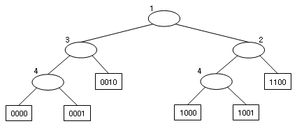
Compressed Binary Trie
A Compressed binary trie is a binary trie that is modified by removing all the nodes with degree one.
There is no branch node whose degree is 1
A BitNumber is added to each branch node, so it consists three fields Left child, Right child and bit field.
The BitNumber tells which bit of the key to be used to decide whether to move to the left or right subtrie.

Slide 6
Example: Search the key 1001 in the Compressed Trie.
Solution:
Compare the search key with root node (branch node). It consists of BitNumber 1, which indicates the branching is to be done depending on the first bit of the data. Since the first bit in the search key is 1, move to the right child of the root.
The right child is the branch node with BitNumber 2, which indicates that the branching is done depending on the second bit of the data.
In the search key, the second bit is 0 and so move to the left branch. Observe that this branch node has BitNumber 4.
The 4th bit in the search key is 1, so move to the right branch.
Finally the element node is reached. Compare the data in the element node with the search key.
The search key is matched with the data in the element node. Hence, the search is successful.
Note: The number of moves for searching 1001 are reduced from 4 in binary trie to 3 in compressed binary trie.

Slide 7
Patricia
Compressed binary trie may be restructured using a type of node called augmented branch node instead of two nodes—branch node and element node.
The new structure formed, is called a Patricia.
An augmented branch node is a compressed trie branch node augmented by another field ‘data’ .
The augmented branch node consists of
The root is 0 iff Particia is empty

Slide 8
The Patricia is obtained from a compressed binary trie by using the rules:
1. Branch nodes are replaced by the augmented branch nodes.
2. Remove all the element nodes.
3. Store the data previously in the element node in the ‘data’ part of the augmented branch nodes.
4. The total number of element nodes in the non-empty compressed binary trie is equal to one more than the total number of branch nodes in it. So, it is necessary to add one extra augmented branch node called header node in the Patricia.
5. For the header node, BitNumber is set to zero, right child link is not used and by using the left child link the remaining structure is set as the left sub-tree to the header node.
6. The assignment of data to augmented branch node is done in such a way that the BitNumber in the augmented branch node is less than or equal to that in the parent of the element node that contained this data.
7. Replace the pointers to element nodes in compressed binary trie by pointers to the respective augmented branch nodes.

Slide 9
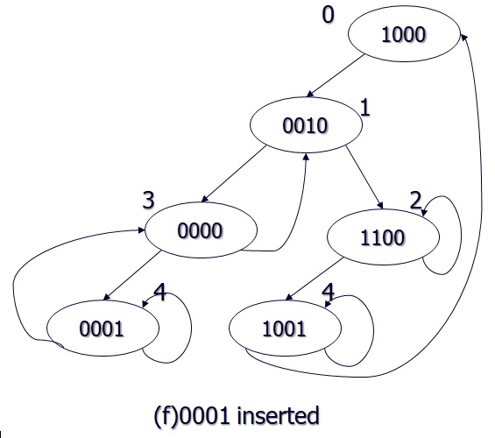
The Patricia obtained from the compressed trie is
Operations on Patricia:
1) Search
2) Insert
3) Delete

Slide 10
Searching Patricia
To search for a key in Patricia, we start at the root and proceed down the tree, using the BitNumber in each node to tell us which bit to examine in the search key.
We proceed left if the bit is 0 and right if it is 1.
The keys in the nodes are not examined at all on the way down the tree.
Eventually, when an element pointer is encountered i.e pointer to node with a lesser BitNumber, the node value is checked with the search key.
Thus, if the key at the node pointed to by this element pointer is equal to the search key, then the search is successful; otherwise, it is unsuccessful.

Slide 11
Example: Search for 1001 in the Patricia

Slide 12
Algorithm for Searching Patricia
Patricia* patricia_ search(Patricia *t, key)
// returns a pointer to node whose data is checked with key
Patricia p, y;
Step 1: IF t = = NULL
Return t // empty tree
[END of IF]
Step 2: SET y = t->left_child; // move to left child
SET p = t;
Step 3:
WHILE y->bit_number > p->bit_number
do
SET p = y;
If key[y->bit_number]= =0
SET y = y->left_child;
ELSE
SET y = y->right_child;
[END of IF]
[END of WHILE]
Step 4: IF key = = y ->data
Write “Element Found”
ELSE
Write “Element Not Found”
[END of IF]
Return y
Step 5: EXIT

Slide 13
Inserting into Patricia
Let key be the element to be inserted. Firstly, search for the key in Patricia. Let q be the node where the patricia_search algorithm terminates. Find the bit position j at which q and key differs. The BitNumber for the new node is j. The position for the new node has to be decided. The new node will be placed in between A and B where A and B can be obtained as follows.
Initially A points to the header node and B points to its left child. Move A and B down the Patricia until the condition A - BitNumber < B - BitNumber < j is satisfied and update the position of A and B. Set node A as B. B is updated based on the bit in the key at position specified by the B - BitNumber. If the bit is 0, update B as B's left child and otherwise as its right child.
As the condition fails, the positions of A and B are fixed and the new node is to be placed in between A and B. If B is a left child of A, the new node is inserted as a left child to A and otherwise new node is inserted as a right child to A.
If the jth bit in the key is 0 then the left link of new node will be self-pointed and right link of new node points to node B. Otherwise, the right link of new node will be self-pointed and left link points to node B.

Slide 14
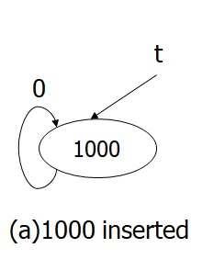
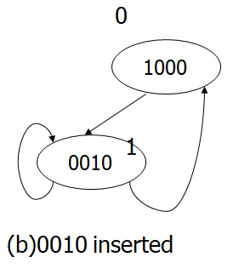
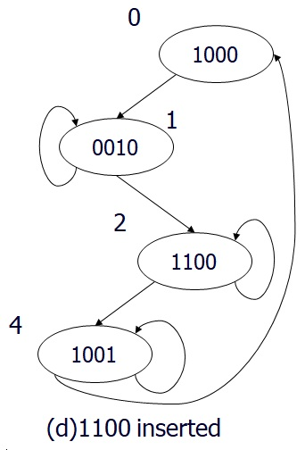
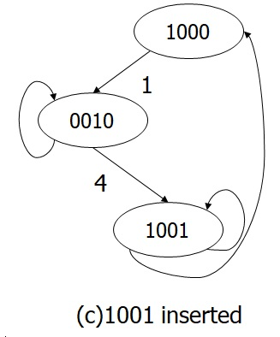
Example 7: Construct a Patricia by inserting elements in the order
1000, 0010,1001,1100,0000 and 0001
Step 2: insert 0010
Step 1: insert 1000
Step 4: insert 1100
Step 3: insert 1001

Slide 15
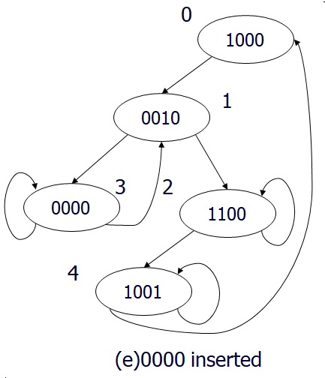
Inserting into Patricia
Step 5: insert 0000
Step 6: insert 0001

Slide 16
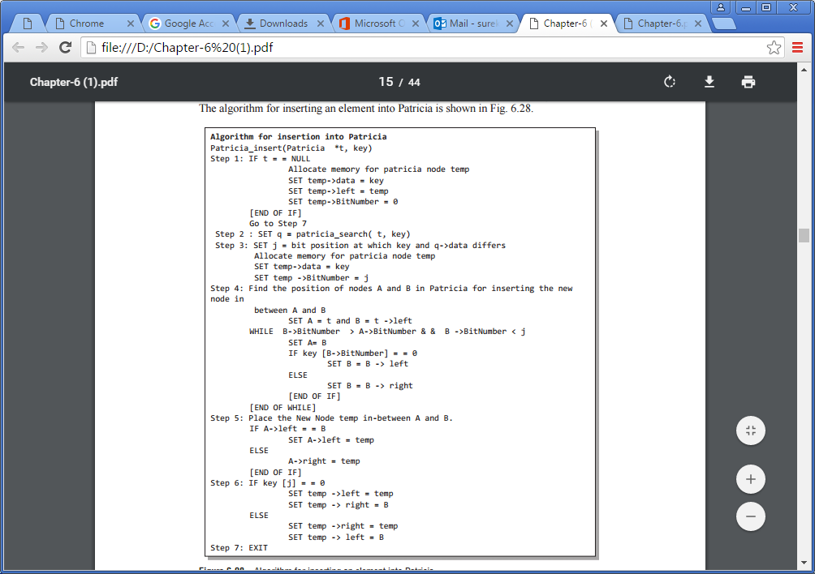

Slide 17
Delete from Patricia
The process of deleting a node from a Patricia can be done by updating the forward and backward pointer.
Let ‘p’ be the node which consists of the element to be deleted.
Deletion in Patricia can be handled as two different cases as listed below.
Case 1: ‘p’ has a self-pointer
Case 2: ‘p’ has no self-pointer.

Slide 18
Delete from Patricia
Case 1: ‘p’ has a self-pointer
There are again two possibilities in this case.
‘p’ is a header node
‘p’ is not a header node.
If ‘p’ is a header node and has a self-pointer, deleting ‘p’ from Patricia will set the Patricia ‘t’ to NULL.
If ‘p’ is not a header node and has a self-pointer, update the forward pointer of parent of ‘p’ to point to the child of ‘p’ and free the node ‘p’ from the Patricia.

Slide 19
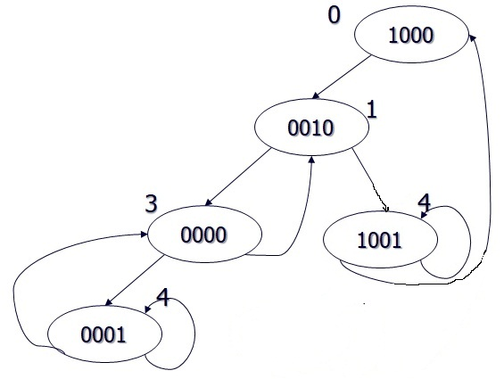
Delete from Patricia
Delete 1100 from the patricia

Slide 20
Delete from Patricia
Case 2: ‘p’ has no self-pointer
If the node ‘p’ has no self-pointer, then identify the nodes ‘q’ and ‘r’ in such a way that q has a back pointer to p and r has a back pointer to q.
Now copy the key value of node q into p.
The back pointer of r is pointed to p.
Set the forward pointer to q from its parent, to point to the child of q.

Slide 21
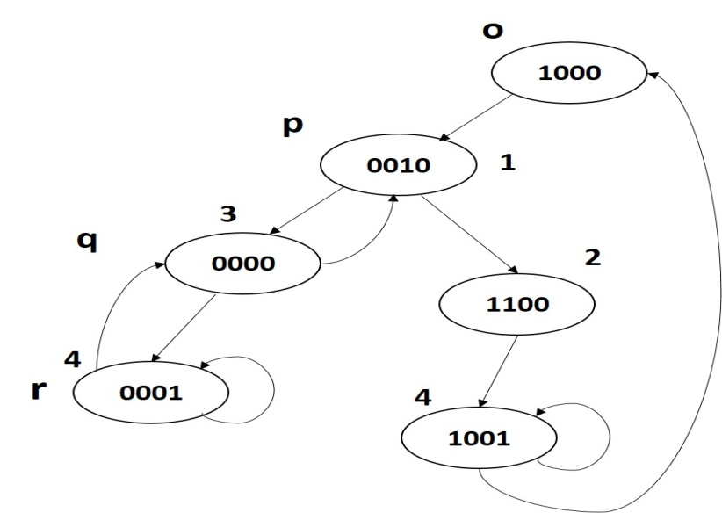
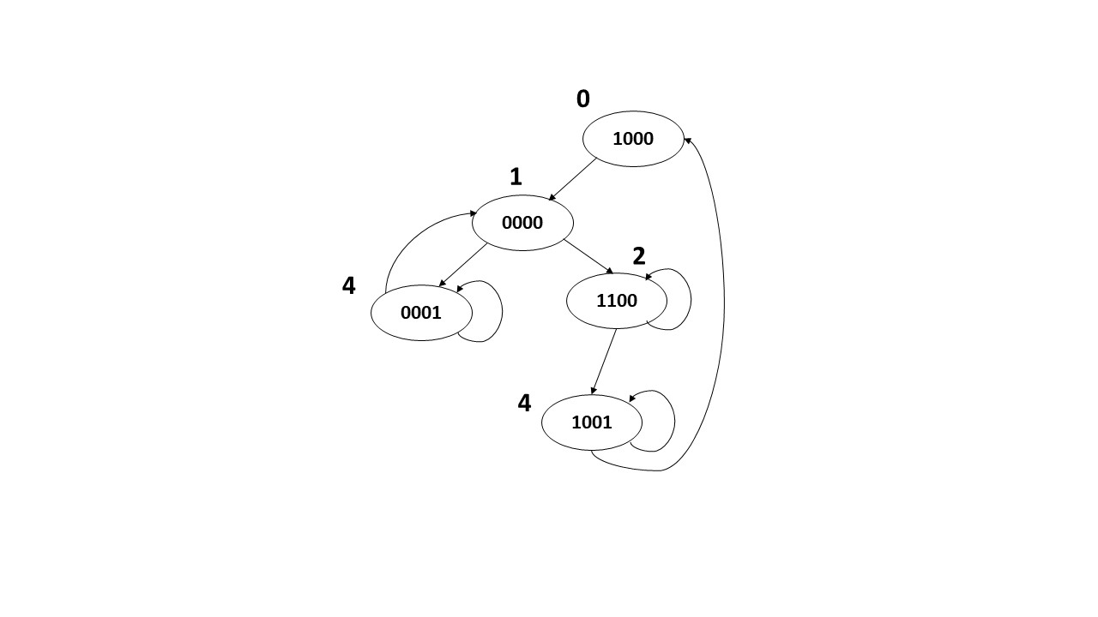
Delete from Patricia
After deleting 0010

Slide 22
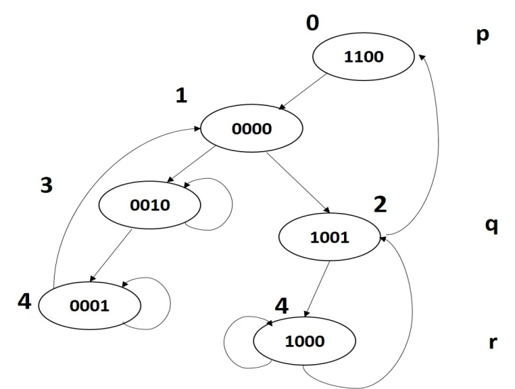
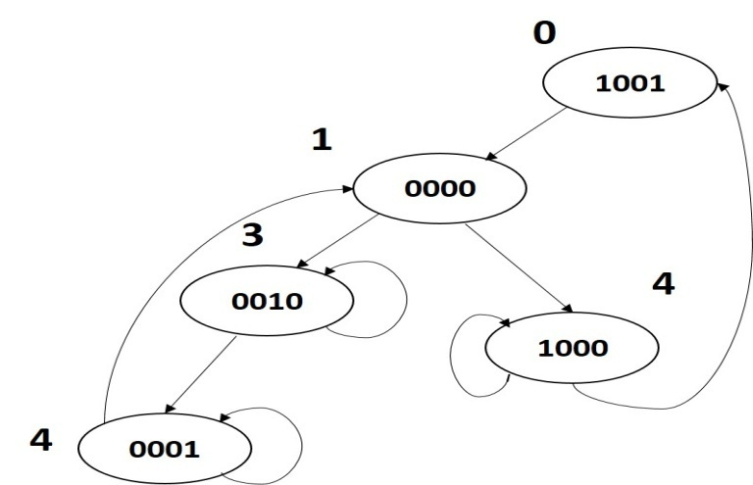
Delete from Patricia
After deleting 1100

Slide 23
MUTI-WAY TRIES
A multi-way trie (or simply trie) is a tree data structure used to store strings of varying length.
The word ‘TRIE’ is extracted from the word ‘RETRIEVAL’.
A trie is used for efficient retrieval of the data, i.e., for performing efficient search on the data.
A trie is a tree of degree m>=2 in which the branching at any level of the tree is determined not by entire key value, but by only a portion of it.
The trie consists of two types of nodes, i.e., element nodes and branch nodes.
The element node has only a data field which consists of the key which is being stored in the trie.
The branch node consists of the pointers to other sub-trees which may again contain pointers to other sub-trees or pointers to element nodes.
The elements or keys are stored in the leaf nodes.
The main advantage of trie data structure is that the strings of similar character prefixes can use the same prefix data and store only tails as separate data.

Slide 24
Example: Consider the trie which stores English words of different lengths. In this trie, each branch node contains 27 pointers, 26 pointers pointing to English alphabets and an extra pointer field which stores a blank character that is used to terminate the keys.
To access a key in the trie, we need to move down in a series of branch nodes following the appropriate branches based on the alphabetical characters forming the key.
All the nodes which neither point to branch nodes or element nodes are represented using NULL pointers.
Thus the depth of the information nodes or element nodes depends on the similarity of the first few characters (prefixes) with its fellow keys.
Operations:
Searching
Insertion
Deletion

Slide 25
Example: Consider set of records consisting of names, AadharID, date of joining, and department name of the employees of an organization. Construct a trie using Aadhar ID as the key field.
Solution:
Let us consider radix 10, so that we will have 10 pointers for each branch node, from 0 to 9 . Examine the digits of the key AadharID from left to right. Using the first digit of AadharID, partition the records into three groups. First group whose AadharID begins with 5 (i.e., Rajani, Arun, and Sushrut), the second group whose AadharID begins with 2 (i.e., Nirmal and Anshul) and the third group that starts with 9 (i.e., Ram). Groups having more than one element are partitioned with the help of the next digit in the key. This process of partitioning is continued until every group has exactly one element in it.

Slide 27
Searching a Trie
For searching an element in the trie, we start searching for the key from the root node which is a branch node.
Let us suppose the key k is made up of k1, k2, k3, kn characters.
The first character of the key k1 is extracted and the respective child pointer in the root node is identified.
If it is an element node, its value is compared with the key and otherwise if it is a branch node, the pointer at next character k2 is considered.
If this pointer points to an element node the key is compared with the element node value and otherwise if it is a branch node, the pointer at next character k3 is considered.
The process is repeated until we reach the element node which is equivalent to the key we are searching for.

Slide 28
Sampling Strategies
F1 : sample(key,i) = keyi
[Branching at level i is done basing on the ith character of the key]
F2 : sample(key,i)= keyn-i+1 where n is number of characters in key.
[Branching at level i is done basing on the n-i+1 character of the key]
F3 : sample(key,i)= keyr(key,i) for r(key,i) is a randomization function
[Branching at level i is done basing on the randomization function. The randomization function will yield any value from 1 to n where n is the no. of characters in key.]
F4 : sample(key,i)= keyi/2 if i is even otherwise
key n-(i-1)/2 if i is odd
[Branching at level i is done basing on the i/2th character if i is even and on n-(i-1)/2th character if i is odd.]

Slide 29
Trie obtained by applying sampling function F1

Slide 30
Trie obtained by applying sampling function F2

Slide 31
Trie obtained by applying sampling function F3
3rd character at level 1, 2nd character at Level 2

Slide 32
If the maximum number of levels is limited to 'L', then all the keys that are synonyms upto level L-1 are entered in the same element node.
Example: The trie obtained by restricting the number of levels to 3. The element nodes can hold more than one key value.

Slide 33
Inserting into a Trie.
Inserting a key into the trie follows the same procedure as the search. Insert telegram into the trie.

Slide 34
After inserting telegram, the trie is

Slide 35
Deletion from a trie
Delete ‘torn’ from the previous trie. The resultant trie is..

Slide 36
Keys with Different Length
When the keys are of different length one key may be a prefix of another key which is violating the no-prefix property.
There are two ways to handle this keys collection. They are:
Case 1: Append a special character such as blank or # to the end of each key.
Case 2: Attach to each branch node a data field, to store the element whose
key exhausts at that node.

Slide 38
Case 2: Attach to each branch node a data field to store the element whose key exhausts at that node. Each node attached with a data field

Slide 39
Compressed Tries
A compressed trie can be obtained by eliminating all branch nodes that have only one child in the trie.
We can improve both time and space performance metrics of a trie with the compressed trie.
When branch nodes with a single child are removed from a trie, we need to keep additional information so that trie operations may be performed correctly.
The additional information stored in a compressed trie can be described by using the structures
compressed tries with digit numbers,
compressed tries with skip fields or
compressed tries with labeled edges.

Slide 40
Compressed Tries with Digit Numbers
In a compressed trie with digit numbers, an additional field digitNumber is associated for every branch node that indicates which digit of the key is used to branch to the next node from this node.

Slide 41
Compressed Tries with Skip Fields
In a compressed trie with skip fields, each branch node has an additional field skip which tells us the number of branch nodes that were originally between the current branch node and its parent.

Slide 42
Compressed Tries with Labeled Edges
In a compressed trie with labeled edges, each branch node has a label associated with it that includes an element field and a skip field. The element field consists of a pointer/reference name to an element node in the sub-trie. The skip field is the number of branch nodes eliminated between this branch node and its parent.

Slide 43
TRIES AND INTERNET PACKET (IP) FORWARDING
Generally, the data packets are transmitted from source to destination in the internet through a sequence of routers.
Each router moves a packet one step ahead to reach the destination.
Consider a packet which is to be transmitted from Delhi to Chennai.
Firstly, the router in Delhi will process the packet and forward it to the next neighbouring router Mumbai and then forwarded to the next neighbouring router Hyderabad and from there the packet is routed to Chennai, the destination.
A routing table with the neighbouring nodes information is used to frame the routing between the source and destination.
A router table is a collection of rules of the form (P,NH) where P is the prefix and NH is the next hop (i.e., the neighbouring node).
For example, the rule (10*, A1) states that the next hop for the packets whose destination address begins with 10 is A1.

Slide 44
It is common that the router table has more than one rule that is matched with the destination address.
In this situation, the next hop is determined by the matching rule which has the longest prefix.
For example, consider there are only two rules (10*, A1) and (1011*, B1) in the routing table that matched with the destination address that begins with the sequence 1011.
By default, the next hop is B1, as the packet forwarding in the internet is done by finding the longest matching prefix.
1-bit Tries
A 1-bit trie is similar to a binary tree where each node consists of a left child, left data, right child, and right data.
The prefix with the length ‘l’ will be stored in the level l of the trie.
At level l, if the rightmost bit of the prefix with length l is 0, the prefix is stored in the left data field or else the prefix is stored in the right data field.
At level i, branching is done using bit i. When the bit i = 1, we move to the right sub-tree and else we move to the left sub-tree.

Slide 45
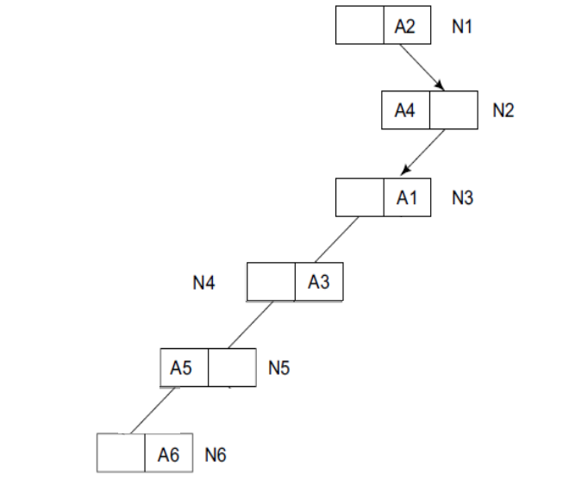
Example: Consider the prefixes. Construct a 1-bit trie.
A1 = 101*,
A2 = 1*,
A3 = 1001*,
A4 = 10*,
A5 = 10000*,
A6 = 100001*.
The height of the 1-bit trie is given as O(W), where W is the length of the longest prefix in the router table.
In the this example, the height of the tree is O(6), as the longest prefix 100001* is with the length 6.

Slide 46
Fixed–stride Tries
We can reduce the access time in Fixed Stride Tries by constructing a trie with lesser height.
The stride of a node is defined to be the number of bits used at the node to determine which branch to take. A node whose stride is s has 2s child fields and 2s data fields.
Example: For the previous prefixes of A1 to A6, Consider the FST with three levels. Assume that the strides are 2, 3, and 2.
In the trie, the root stores the prefix with the length 2, the level 2 node stores the prefixes with the length of 5 (2+3), and the level 3 stores the prefix with 7, i.e., 2+3+2.
This poses a problem as the length of the prefixes is different from the storable length.
Consider the prefix A2 = 1* with the length of 1. To get rid of this problem, the prefix with the different length is expanded to the next admissible length.
In the above example, A2 = 1* is expanded to A2a = 10* and A2b = 11*. However, A4 = 10*, which is a longer match is selected instead of A2a, and it is removed.

Slide 47
The expanded strides are:
A1a = 10100*
A1b = 10101*
A1c = 10110*
A1d = 10111*
A2a = 10* ( same as A4)
A2b = 11*
A3a = 10010*
A3b = 10010*
A4 = 10*
A5 = 10000*
A6a = 1000010*
A6b = 1000011*

Slide 48
Variable – stride Tries
In a variable–stride trie (VST), nodes at the same level may have different strides.
The stride for the root is 2, the left child of root node is 5 and that for the root’s right child is 3.
As a result, the memory required by this VST is 4(root) + 32(left child of root) + 8 (right child of root) = 44.

